Slide 1
TidyText
Tidy Text Mining in R

Slide 2
About
TidyText is the text mining entry to the Tidyverse set of packages in R
Other tidyverse packages include:
dplyr
ggplot2
readr
tidyr
stringr

Slide 3
Tidy Format
The tidy data format was outlined by Hadley Wickham and consists of the following rules:
Each Variable is a column
Each observation is row
Each type of observation is a table
A common way to think about tidy data is that it is “long” rather than “wide”.

Slide 4
What is tidy text?
The authors of the tidytext library define the tidy text format as:
A table with one token per row
A token is usually a word, but can be an n-gram, paragraph, or even a document
In contrast, one of the most common text mining formats is the document term matrix (DTM):
Every document is a row
Every word is a column
The value is how often that term appears in the document
The DTM is still necessary for certain processes such as document clustering and topic modeling. The tidytext library has easy to use function to convert between the two formats

Slide 5
What does a Tidy format get us?
A Tidy format allows us to use the Tidyverse tools to easily clean, summarize, alter, and graph data:
Clean and alter data with tidyr and dplyr
Summarize data with dplyr
Graph in ggplot2
String manipulation with stringr
Functional programming with purr
And so much more

Slide 6
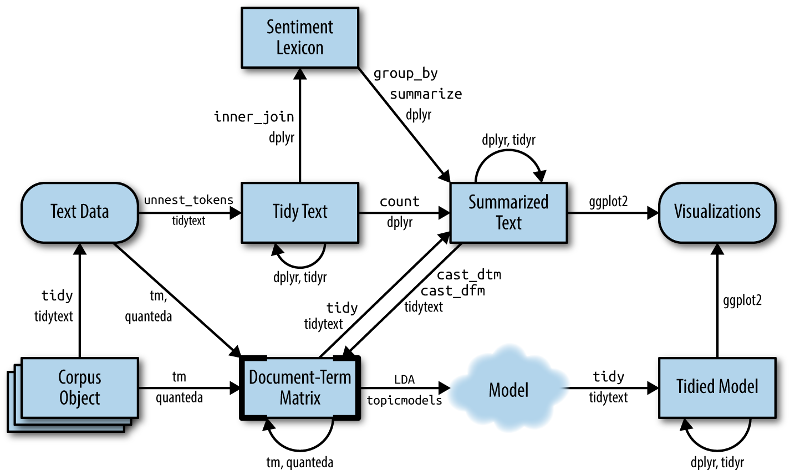
The text mining pipeline with tidytext and other packages

Slide 7
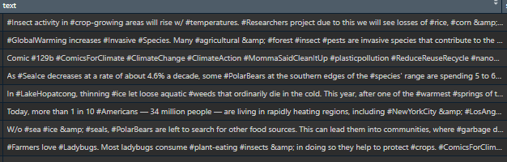
A Short Example – Getting Tweet data
Download a set of 10,000 English language tweets tagged with #climatechange (using the rtweet package)
The text of the tweets looks messy:

Slide 8
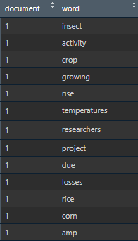
A Short Example – Cleaning the data
The data needs to be cleaned
Remove http/https
Unnest the tweets to fit the tidy format
Remove Stop Words – common words
Now each row is a word in a tweet and we have tidy data set

Slide 9
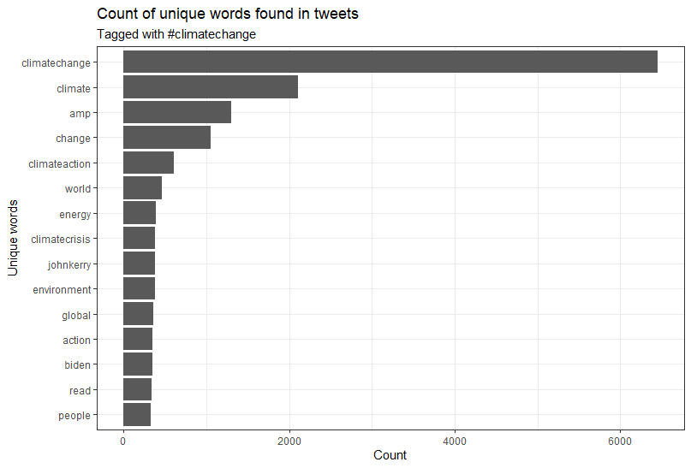
A Short Example – Basic Exploratory Data Analysis
Using dplyr we can quickly find that, after cleaning the data, there are 21,871 unique words from the original 10,000 tweets.
A graph of the 15 most common words:

Slide 10
A Short Example – Tweet sentiment
A common task in text analysis is to examine the sentiment of a document using a sentiment lexicon
The tidytext and textdata packages give you access to four different lexicons via the get_sentiments() function
In this case, using the NRC Word-Emotion Association Lexicon, we assign a numerical value to the tweets where a negative number is a negative sentiment and a positive sentiment
Minimum | Mean | Median | Maximum
-7 | 0.6849 | 1 | 9

Slide 11
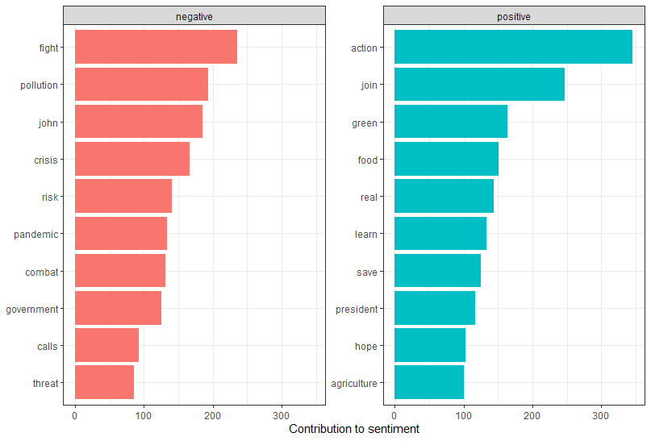
A Short Example – Tweet sentiment
The next question is what are the most common positive and negative words in these tweets

Slide 12
A Short Example – Topic Modeling
Topic Modeling is a technique that separates documents, or tweets in this case, into groups, similar to clustering
A common technique in topic modeling is Latent Dirichlet Allocation (LDA), which is available in the topicmodels package in R
But the topicmodels package uses DTMs, so we have to use the cast_dtm() to do run the model and then the tidy() function to bring our results back to the tidyverse

Slide 13
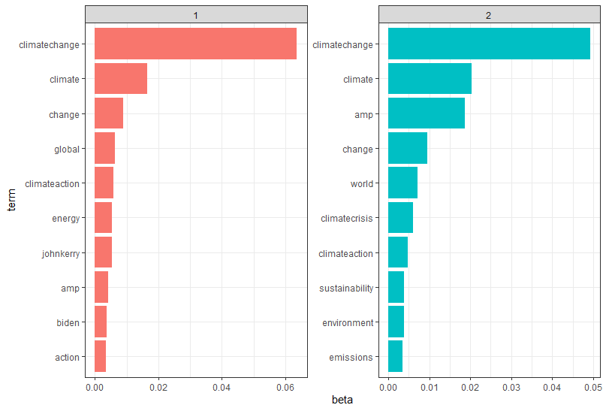
A Short Example – Topic Modeling
This case assumes 2 topics for the model. Below are the terms most likely in each topic

Slide 14
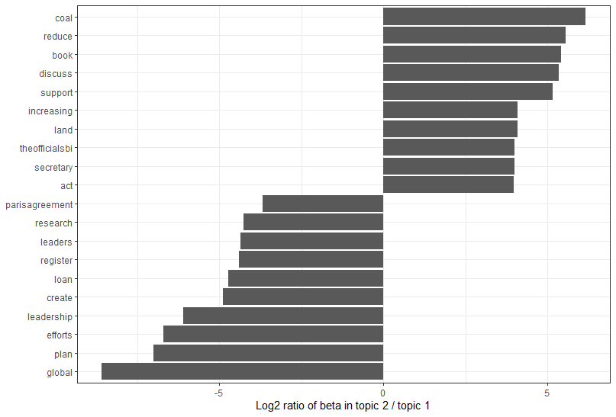
A Short Example – Topic Modeling
Alternative question might be which terms lead more weight to each topic. In this case the log ratio shown. For reference if the log ratio is 1, then a term is twice as likely to be in topic 2 than topic 1, and a log ratio of -1 would mean the opposite

Slide 15
Resources
The definitive text on tidytext is the book Text Mining with R by Julia Silge and David Robinson. Many of the examples here are based on the work in the book. It is available, for free, here: https://www.tidytextmining.com/
The idea of using climate change tweets: https://www.earthdatascience.org/courses/earth-analytics/get-data-using-apis/text-mining-twitter-data-intro-r/
Script from this presentation is on CVP Gitlab, under snippets, as “Tidy Text Presentation.R” (120 lines of code!)

